Slide 1







TITLE : Data Analytics and Visualization Capstone Project
NAME : PATAN AFROZ KHAN
DATE : 08-02-2025

Slide 2



OUTLINE
Executive Summary
Introduction
Methodology
Results
Visualization – Charts
Dashboard
Discussion
Findings & Implications
Conclusion
Appendix

Slide 3

EXECUTIVE SUMMARY
Objective: Analyze programming languages and database trends using job postings data.
Key Insights:
• Trends in programming languages (current and next year).
• Trends in database technologies (current and next year).
Implications: Insight into skills in demand for professionals and industry trends.

Slide 4

INTRODUCTION
What is this report about?
This report provides insights into job market trends in programming languages and databases.
Who is it for ?
Job seekers, recruiters, and educational institutions.
What will the reader gain ?
A clear understanding of skills in demand to align their career and hiring strategies.

Slide 5

METHODOLOGY
Data Sources:
GitHub Jobs API: Collected job postings data for programming and database trends.
Web scraping: Extracted salary trends from popular- languages.csv.
• Data Collection:
Automated data retrieval, cleaning, and preparation.
• Tools Used:
Python, Excel, Cognos/Looker Studio for visualization.

Slide 6
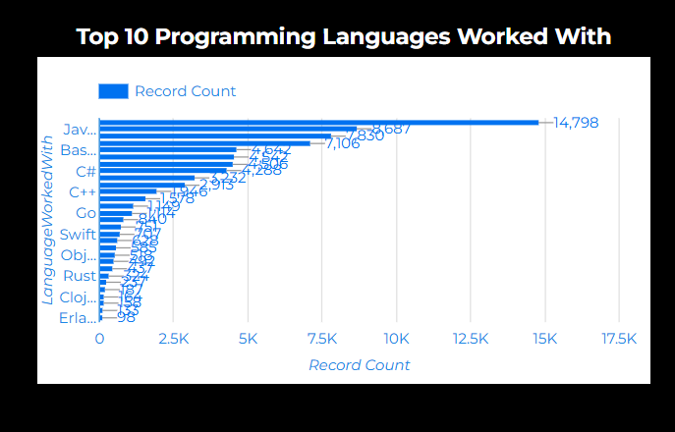
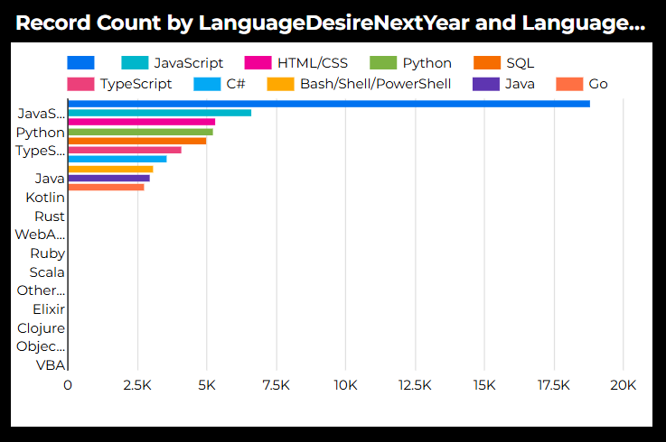
PROGRAMMING LANGUAGE TRENDS
Current Year
Next Year

Slide 8
PROGRAMMING LANGUAGE TRENDS - FINDINGS & IMPLICATIONS
Findings
Most Demand Language JavaScript
Python
HTML/CSS
Implications
JavaScript shows a decline in demand, dropping from 8,687 job postings to 6,630
Python may be impacting JavaScript’s. Python growth from 4542 to 5239
HTML decrease from 7830 to 5328

Slide 9
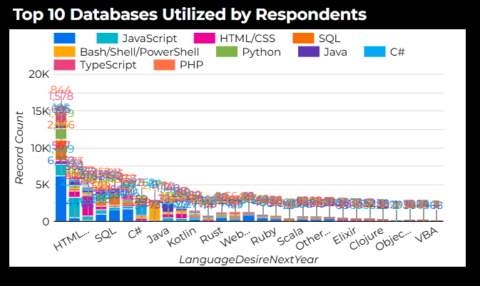
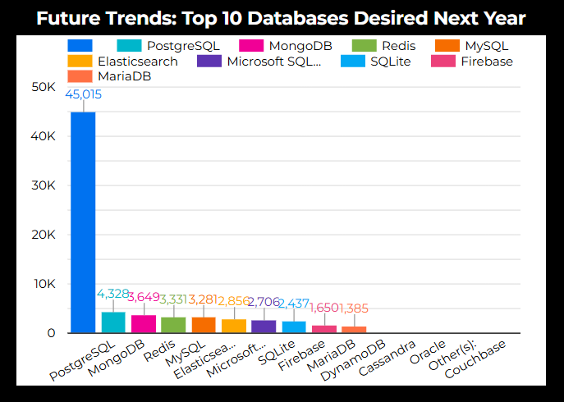
DATABASE TRENDS
Current Year
Next Year

Slide 10
DATABASE TRENDS - FINDINGS & IMPLICATIONS
Findings
Most Demand Language JavaScript
Python
HTML/CSS
Implications
JavaScript shows a decline in demand, dropping from 8,687 job postings to 6,630
Python may be impacting JavaScript’s. Python growth from 4542 to 5239
HTML decrease from 7830 to 5328

Slide 11

DASHBOARD
Git hub Dashboards :
https://github.com/Afrozkhan32/IBM-Copstone-Dashboard.git
Part-A Dashboard:
IBM-Copstone-Dashboard/_ Part-A_Dashboard at main · Afrozkhan32/IBM-Copstone-Dashboard
Part-B Dashboard:
IBM-Copstone-Dashboard/Part-B-Dashboard.pdf at main · Afrozkhan32/IBM-Copstone-Dashboard
Final Dashboard:
https://lookerstudio.google.com/s/onTJJnWIfyM

Slide 12
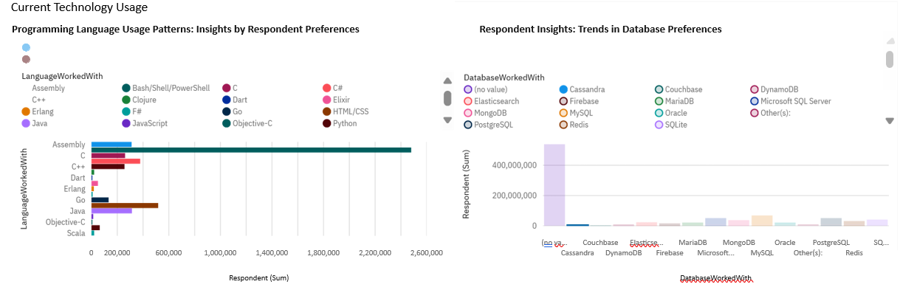
DASHBOARD TAB 1

Slide 13
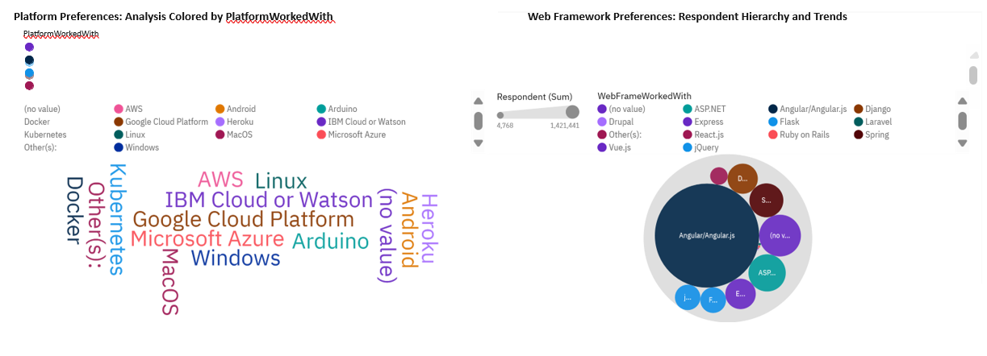
DASHBOARD TAB 2

Slide 14
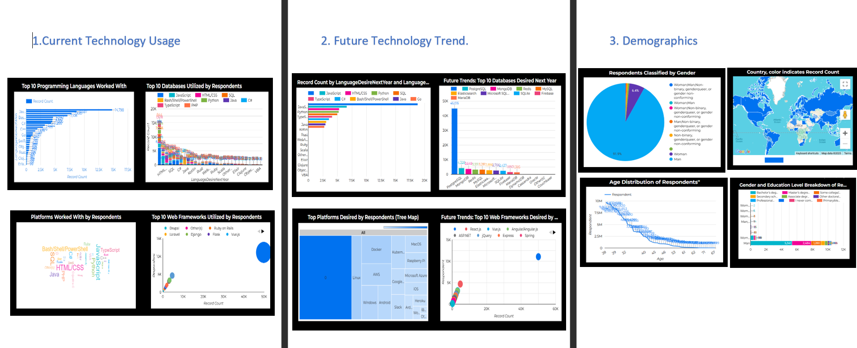
DASHBOARD TAB 3
Screenshot of dashboard tab 3 goes here

Slide 15
DISCUSSION
Use this section to discuss overall trends observed across programming languages and databases, tying them to broader industry needs.

Slide 16
OVERALL FINDINGS & IMPLICATIONS
Findings
JavaScript Decline – JavaScript job postings have decreased from 8,687 to 6,630, indicating a shift in industry demand.
Programming Language Shifts – Emerging languages such as TypeScript and Rust are gaining traction, possibly replacing traditional languages in some areas.
Database Trends – Some SQL-based databases are declining, while NoSQL and cloud-based databases like MongoDB and Firebase are on the rise due to scalability needs.
Implications
For Job Seekers: Developers should adapt to changing trends, focusing on emerging technologies like cloud databases, AI-driven development, and modern frameworks.
For Employers: Companies must invest in training and modernize their technology stacks to keep up with evolving database and programming language trends.
For Educators: Universities and coding bootcamps should update their curriculum to focus on in-demand skills such as cloud computing, AI development, and modern database management.

Slide 17

CONCLUSION
The decline of JavaScript (from 8,687 to 6,630 job postings) suggests a shift towards modern alternatives like TypeScript and Rust.
Growing Adoption of NoSQL & Cloud Databases – Traditional SQL databases are being challenged by NoSQL solutions (e.g., MongoDB, Firebase) due to scalability and flexibility demands.
Industry Trend Insights – Companies are focusing on cloud-based architectures, AI integration, and modern web frameworks, affecting hiring patterns.
Recommendations for Professionals – Developers should upskill in emerging technologies (e.g., cloud computing, AI frameworks, modern databases) to stay relevant in the job market.

Slide 18

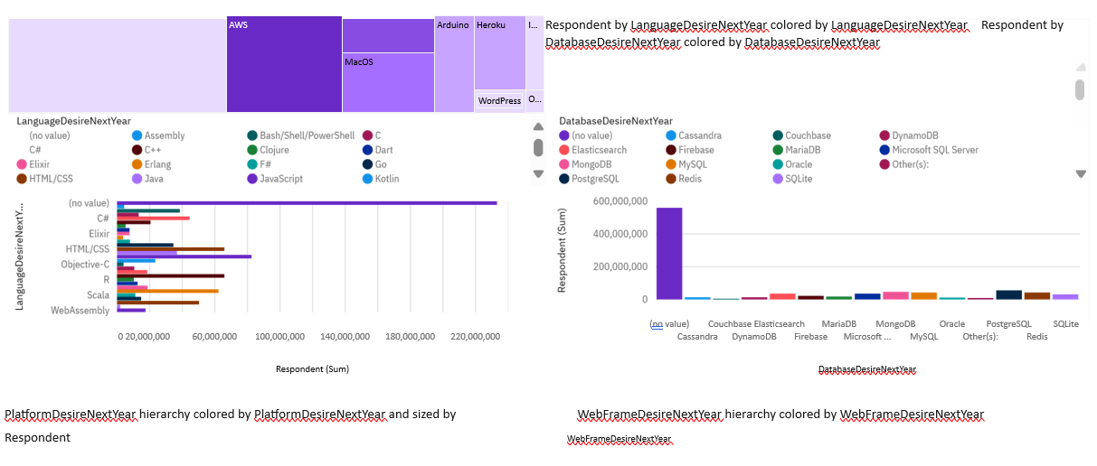
APPENDIX

Slide 19
JOB POSTINGS
In Module 1 you have collected the job posting data using Job API in a file named “job-postings.xlsx”. Present that data using a bar chart here. Order the bar chart in the descending order of the number of job postings.
GitHub Link:
IBM-Copstone-Dashboard/Collecting_job_data_using_APIs-Lab (1) (2).ipynb at main · Afrozkhan32/IBM-Copstone-Dashboard

Slide 20
POPULAR LANGUAGES
In Module 1 you have collected the job postings data using web scraping in a file named “popular-languages.csv”. Present that data using a bar chart here. Order the bar chart in the descending order of salary.
GitHub Link:
IBM-Copstone-Dashboard/Web-Scraping-Lab (1).ipynb at main · Afrozkhan32/IBM-Copstone-Dashboard

